Slide 1




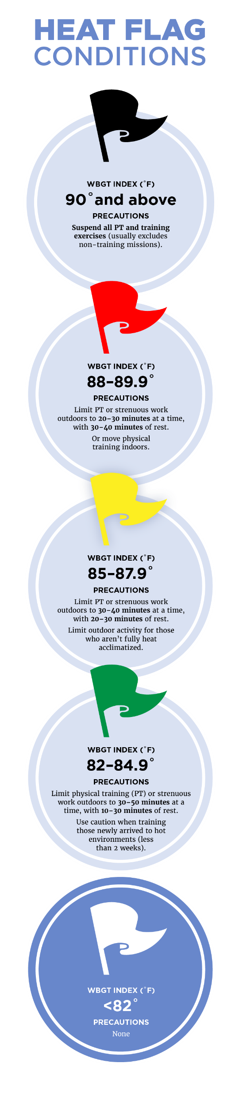

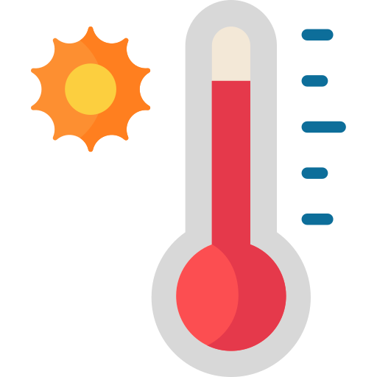


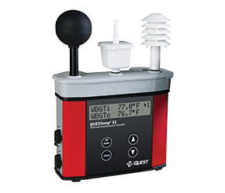
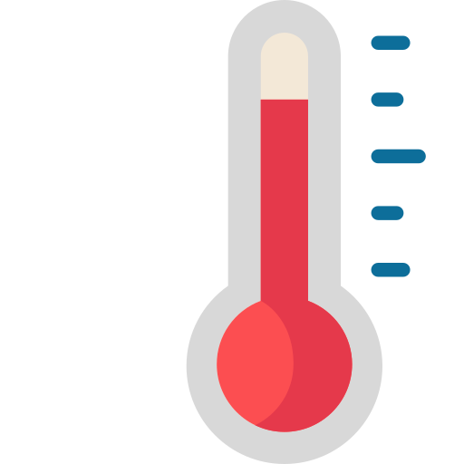


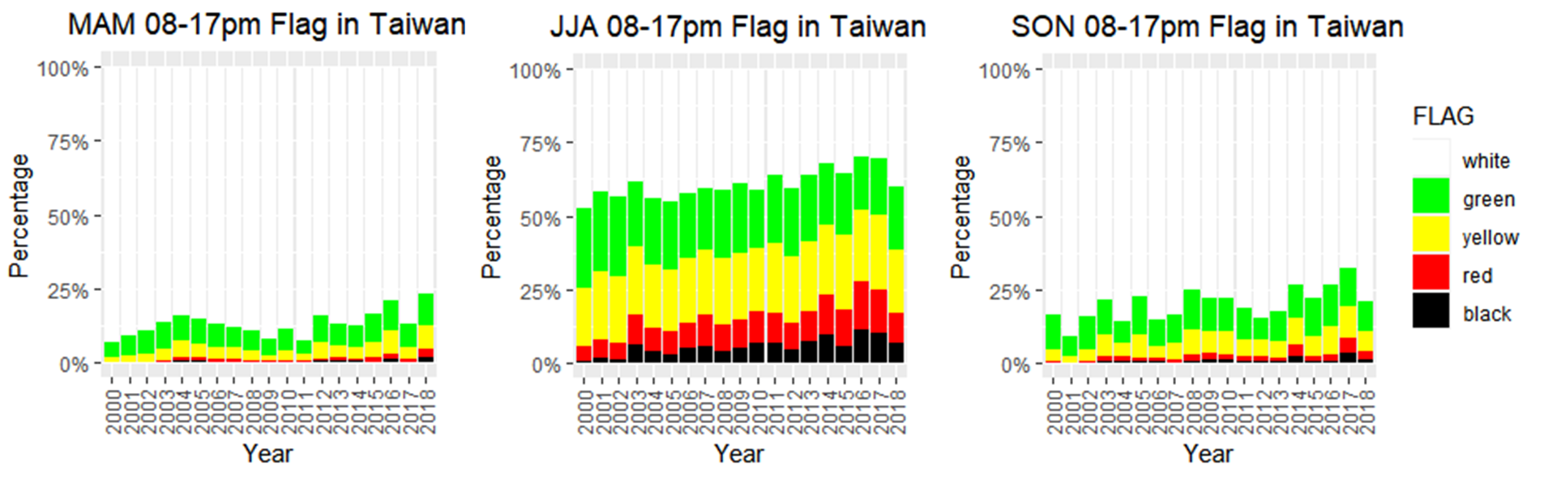
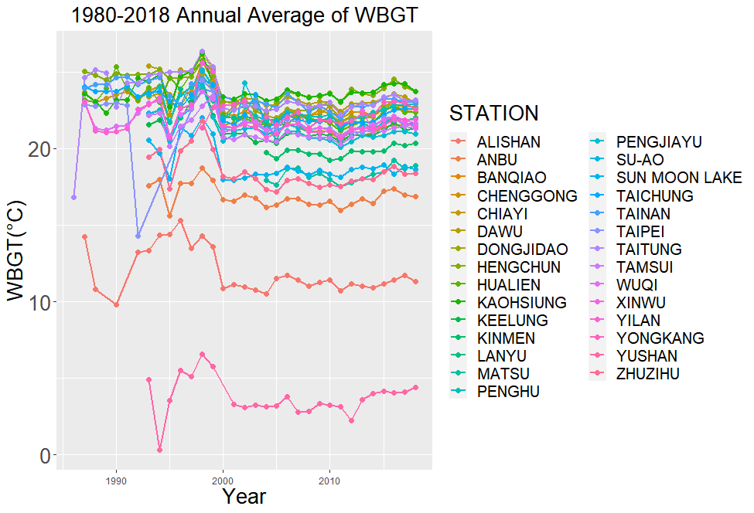
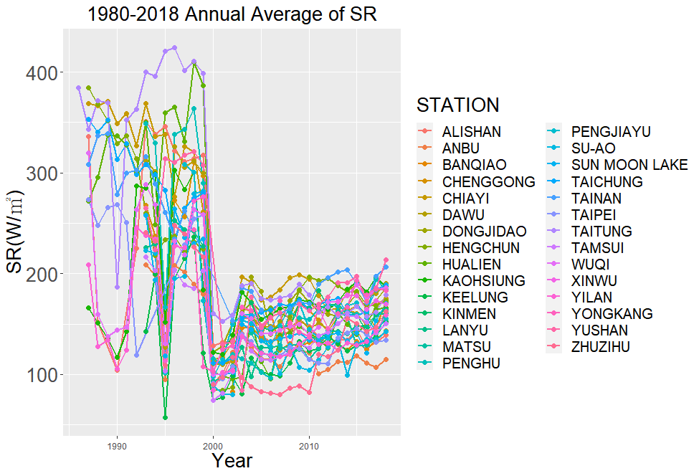
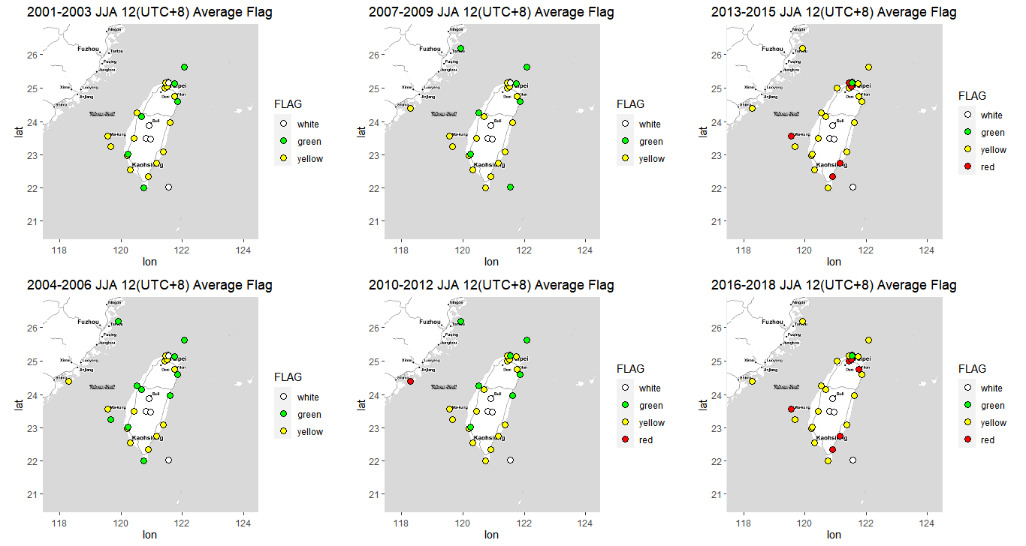
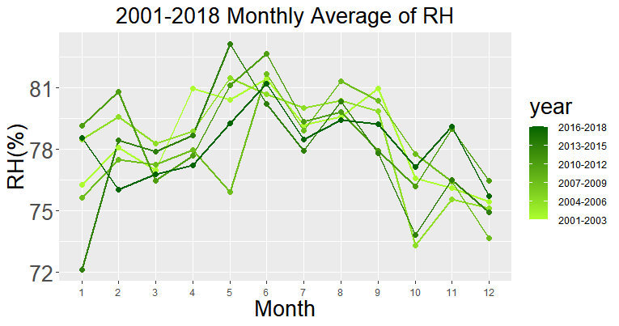
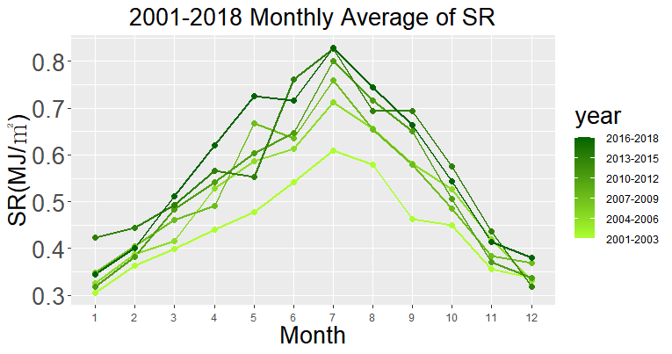


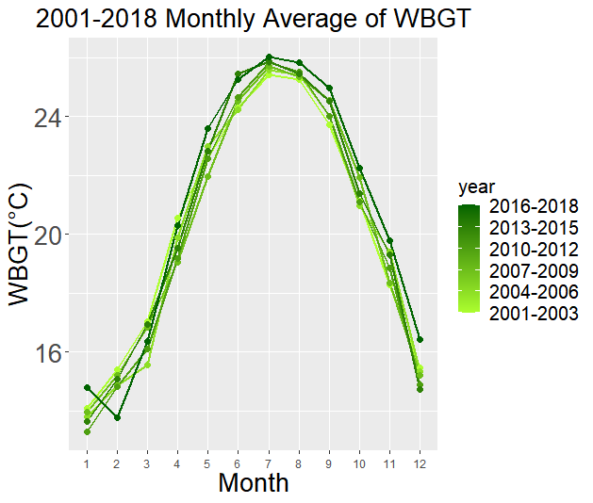



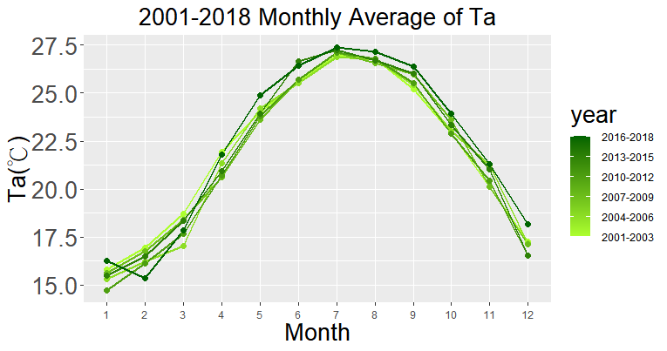
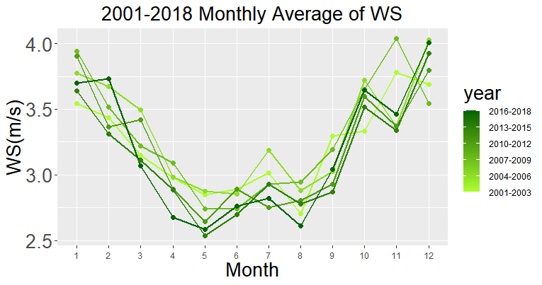

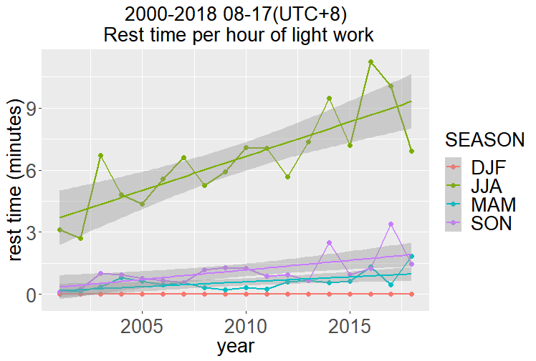
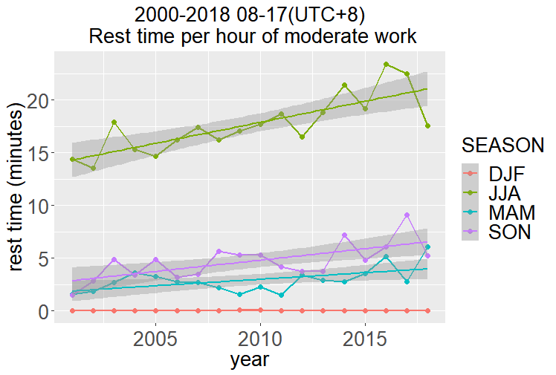
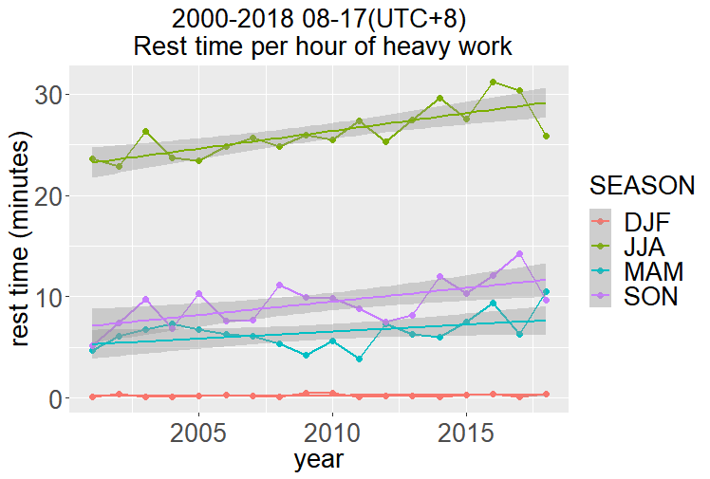
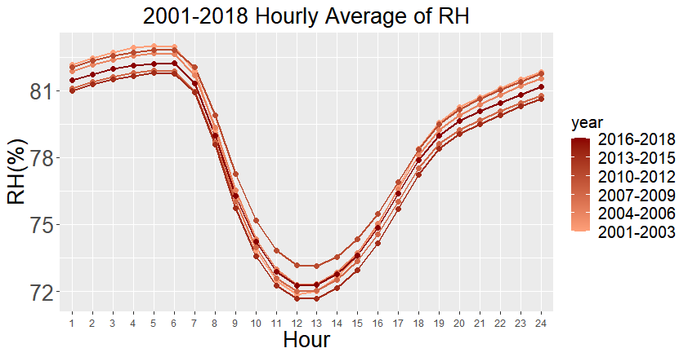
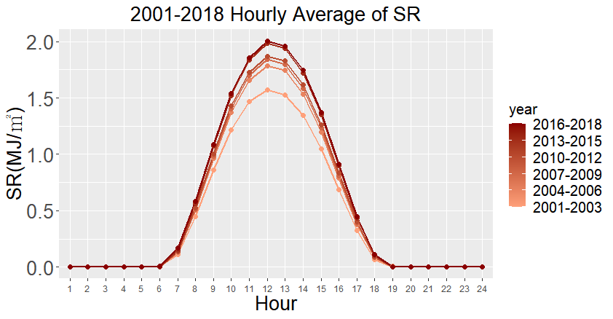
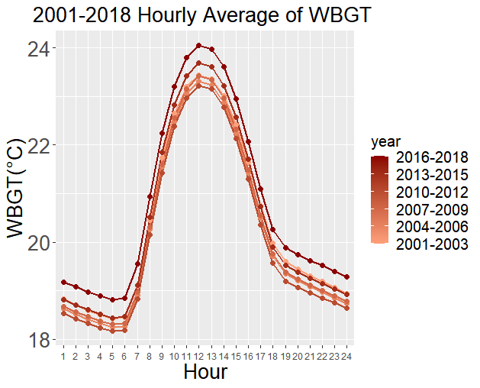
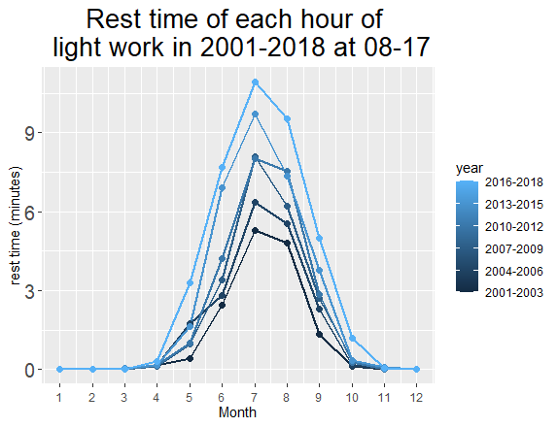
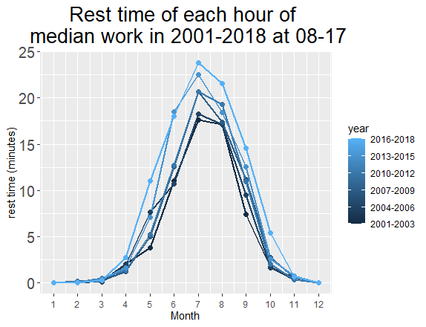
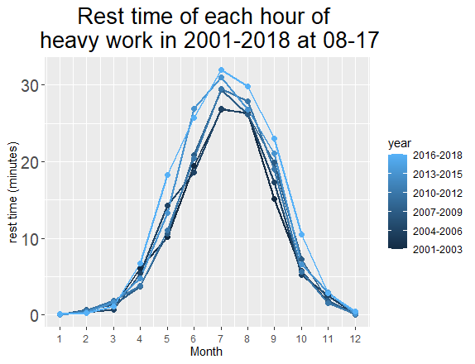
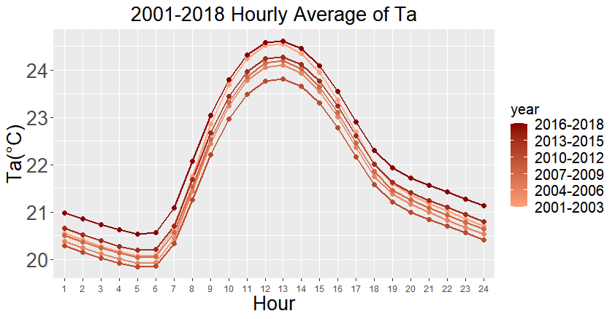
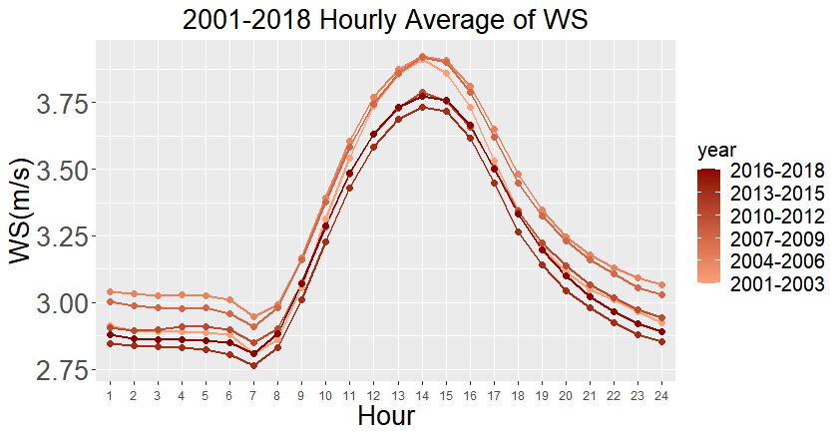




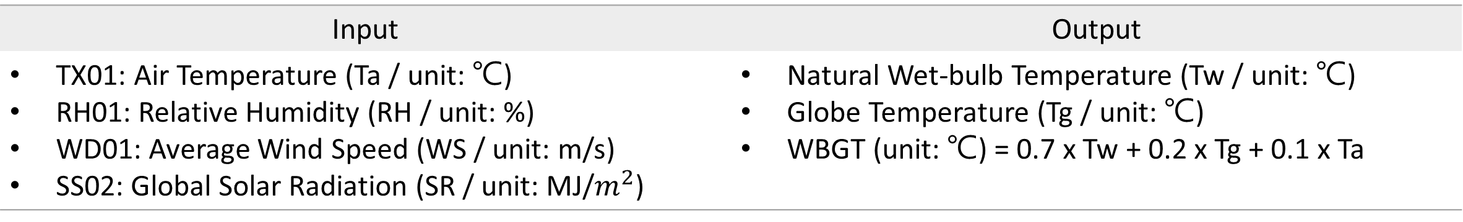
Analysis of Outdoor
Wet-bulb Globe Temperature in Taiwan
Man-Fang Liang^{1,2}, Yi-Chi Wang² and Yu-Chi Lee²
¹Department of Public Health, National Taiwan University, Taipei, Taiwan
²Research Center for Environmental Change, Academia Sinica, Taipei, Taiwan
Contact: b07801003@ntu.edu.tw
Abstract
Wet-bulb globe temperature (WBGT), a weighted combination of natural wet-bulb temperature, globe temperature and dry-bulb temperature, is the most widely used index of heat stress nowadays. However, only dry-bulb temperature was provided by routine meteorological measurements, and monitors may be overheating when measuring outdoor WBGT under the sun. Therefore, this study estimates WBGT with four parameters including temperature, humidity, wind speed, and solar radiation, based on the hourly historical data from the CWB, Taiwan. To begin with, the study attempts to visualize the change of WBGT among years, months, and hours. Furthermore, the study applies the calculated WBGT to two standards, including Heat Flag Conditions use by the U.S. military and Rest-work Schedule during Operations with Heat Exposure used by Taiwan government, to see the change of flag conditions and rest time per hour regulated in Taiwan.
1. Wet-bulb Globe Temperature (WBGT)
2. Heat Flag Conditions
Humidity + Radiation + Wind
Radiation + Wind
Air Temperature
Tg
Tw
Ta
Heat flag conditions in the military describe the risk of suffering heat illness (heat cramps, heat exhaustion, heat injury, and heat stroke) during work or exercise outside in the heat, which are currently based on WBGT. Currently, there are 5 flag conditions in use by the U.S. military shown in Fig. 5. After no flag, each color corresponds with increasing restrictions to work or training based on personnel’s heat acclimatization status and training intensity.
Source: Military heat flag conditions explained | HPRC
(https://www.hprc-online.org/physical-fitness/environmental-extremes/military-heat-flag-conditions-explained)
Outdoor WBGT
0.7
Natural Wet-bulb Temperature (Tw)
0.2
Globe Temperature (Tg)
0.1
Dry-bulb Temperature (Ta)
WBGT equations
(Bernard, 2012)
+
+
Fig. 1
Heat Stress Monitor
Estimation of WBGT
Data Source: Central Weather Bureau
Data Type: Hourly Data of Taiwan Weather Stations
Refernces: Liljegren et al. 2008
Input | Output
TX01: Air Temperature (Ta / unit: ℃) RH01: Relative Humidity (RH / unit: %) WD01: Average Wind Speed (WS / unit: m/s) SS02: Global Solar Radiation (SR / unit: MJ/$m^{2}$) | Natural Wet-bulb Temperature (Tw / unit: ℃) Globe Temperature (Tg / unit: ℃) WBGT (unit: ℃) = 0.7 x Tw + 0.2 x Tg + 0.1 x Ta
Fig.7 2000-2018 Annual proportion of 5 flag conditions in each season
Annual Average
There is a rapid drop in solar radiation in 2000 at every station shown in Fig. 2, corresponding to the trend of WBGT. Before that, there are no consistent trends of SR across all stations probably due to the personal or instrumental error. Therefore, in the following analysis, this study only uses the data after 2000 to avoid errors.
Fig. 8 JJA 12(UTC+8) Triennial average flag conditions at each station in Taiwan
Monthly Average
Fig. 2 Annual Average of WBGT & Global Solar Radiation
3. Rest-work Schedule during Operations with Heat Exposure
Workload
WBGT(°C)
Light Work
30.6 | 31.4 | 32.2 | 33.0
28.0 | 29.4 | 31.1 | 32.6
25.9 | 27.9 | 30.0 | 32.1
Only performing arm movements in sitting or standing positions to operate machines
Moderate Work
Lifting or pushing objects of general weight while walking
Heavy Work
Full-body exercises such as shoveling, digging and pushing
Continuous work | Rest 15 Work 45 | Rest 30 Work 30 | Rest 45 Work 15
Rest time per hour(Unit: Minutes)
Fig. 3 2001-2018
Monthly Average of WBGT
Fig. 4 2001-2018 Monthly Average
of all Parameters of WBGT
Hourly Average
Fig. 9 2001-2018 08-17(UTC+8) Annual average of rest time per hour for each season
Fig. 5 2001-2018
Hourly Average of WBGT
Fig. 6 2001-2018 08-17(UTC+8)
Hourly Average of all Parameters of WBGT
Fig. 10 2001-2018 08-17(UTC+8) Three-year average of rest time per hour
4. Summary
Annual
Monthly
Hourly
WBGT increases since 2000. Especially hourly average in 2016-2018. (Fig. 2 & 3 & 5)
Heat Flag Conditions used in the U.S.
“No flag” hours declines year by year. (Fig. 7)
Extreme conditions such as red & black flag increases from 0 to 5 stations. (Fig. 8)
Hourly
Relative Humidity decreases year by year. (Fig. 6)
Monthly
Hourly
Global Solar Radiation
sharply increases in MAM, JJA, SON. (Fig. 4)
sharply increases in the daytime. (Fig. 6)
Rest-work Schedule during Operations with Heat Exposure used in Taiwan
From May to October, annual average of rest time increases since 2000. (Fig. 10)
Monthly
Hourly
Air Temperature increases year by year. (Fig. 4 & 6)
JJA 08-17 Rest-work Schedule (Fig. 9) | Light Work | Moderate Work | Heavy Work
2000 | 3 mins | 15 mins | 24 mins
2017 | 10 mins | 22.5 mins | 30 mins
Monthly
Hourly
Wind Speed decreases year by year. (Fig. 4 & 6)

Slide 2
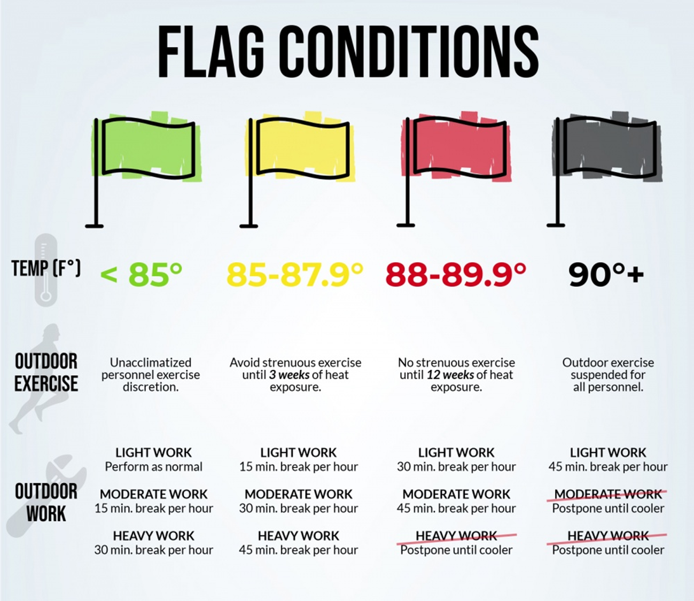
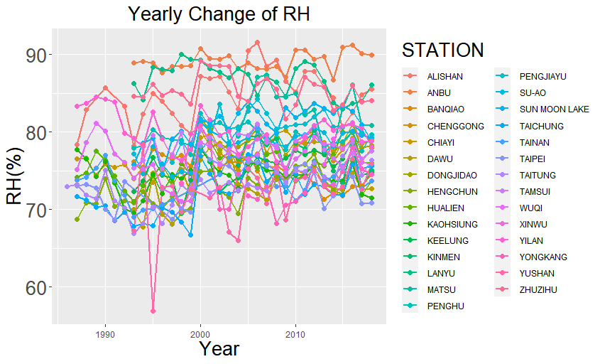
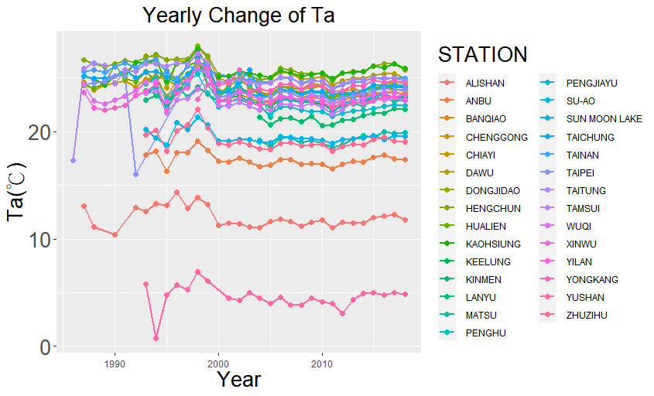
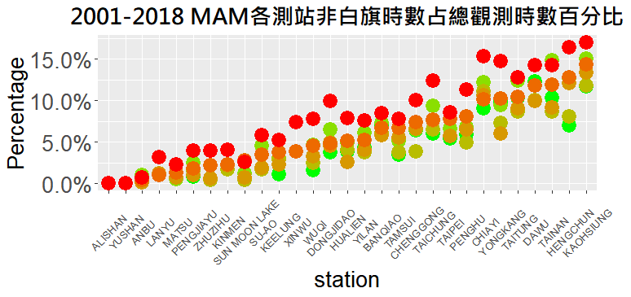
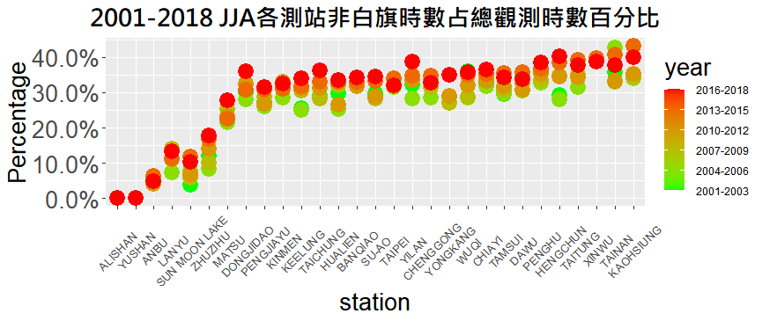
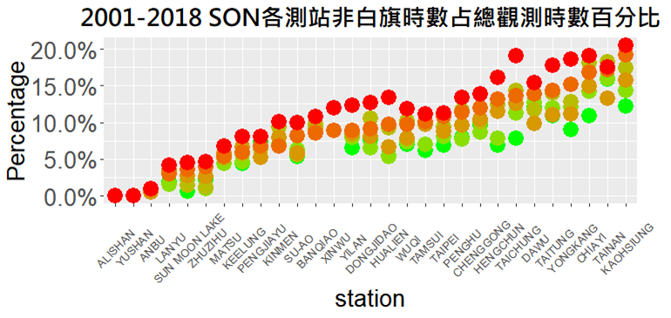
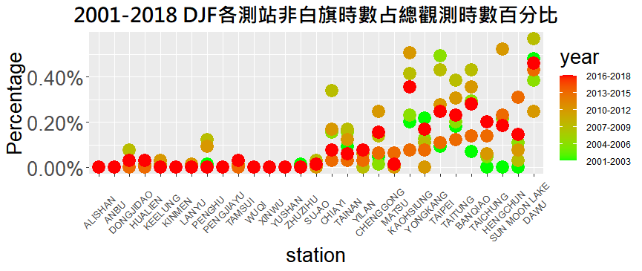
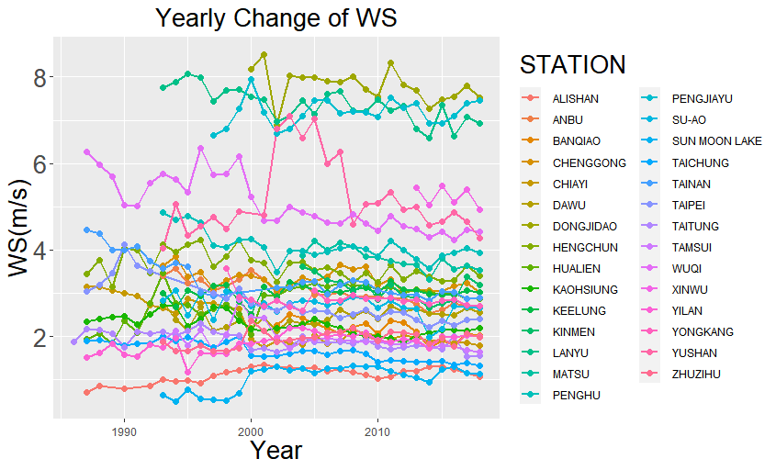
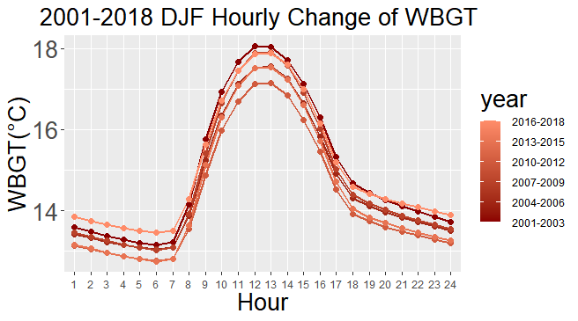
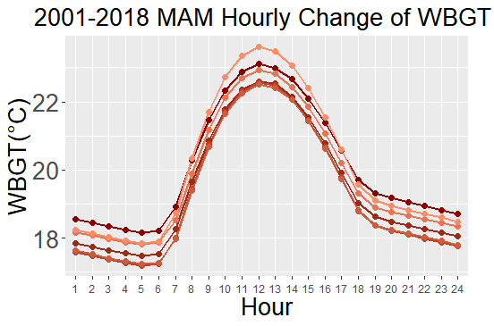
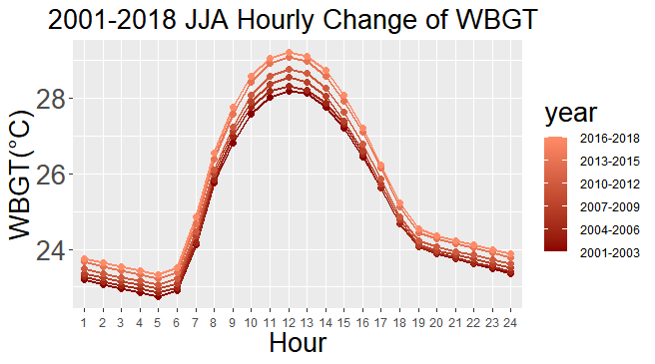
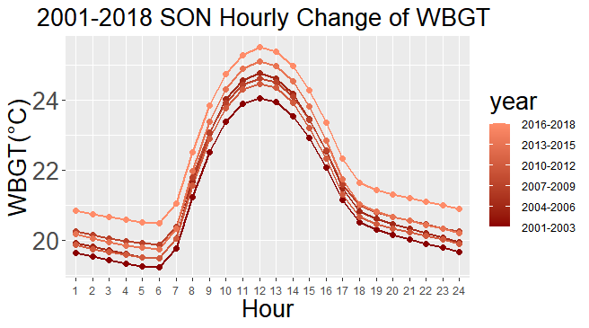
Analysis of Outdoor Wet-bulb Globe Temperature
based on Hourly Data of Taiwan Weather Stations
WBGT
0.7
自然濕球溫度
0.2
黑球溫度
0.1
乾球溫度
+
+
As Fig. 2.1 shows, declining in 2000 at all of the stations in Taiwan, WBGT has gradually increased after that. There is a rapid drop of globe solar radiation(SR) in 2000 at every stations shown in Fig. 2.2, which corresponds to the trend of WBGT. Before the falling of SR in 2000, there are not consistent trends across all the stations probably due to the personal or instrumental error. Therefore, in the following analysis, I only use the data after 2000 to avoid errors.
時間(分鐘)
時量平均綜合溫度熱指數（°C）
輕工作
中度工作
重工作
Fig. 4 2001-2018 Monthly Average
of all Parameters of WBGT
以坐姿或立姿進行手臂部動作操縱機器者
走動中提舉或推動一般重量物體者
鏟、掘、推等全身運動之工作者
Fig. 3.1 shows that monthly average of WBGT has slightly increased since 2001, which the trend of monthly average of Dry-bulb Temperature(Ta) is highly correspond to shown in Fig 3.4. Fig. 3.3 clearly implies that solar radiation(SR) has progressively increased since 2001 especially in MAM, JJA and SON. Wind speed(WS) has declined since 2001 as Fig. 3.5 shows.
連續作業 | 30.6 | 28.0 | 25.9
休息15:作業45 | 31.4 | 29.4 | 27.9
休息30:作業30 | 32.2 | 31.1 | 30.0
休息45:作業15 | 33.0 | 32.6 | 32.1
每小時作息時間(分鐘)
連續作業 | 休息15:作業45 | 休息30:作業30 | 休息45:作業15
30.6 | 31.4 | 32.2 | 33.0
28.0 | 29.4 | 31.1 | 32.6
25.9 | 27.9 | 30.0 | 32.1
時量平均綜合溫度熱指數(°C)
輕工作
坐姿或立姿進行手臂部動作操縱機器者
中度工作
鏟、掘、推等全身運動之工作者
重工作
走動中提舉或推動一般重量物體者
註：高溫作業勞工如為連續暴露達一小時以上者，以每小時計算其暴露時量平均綜合溫度熱指數，間歇暴露者，以二小時計算其暴露時量平均綜合溫度熱指數，並依此表規定，分配作業及休息時間。
時量平均綜合溫度熱指數 = $\frac{\sum_{k=1}^{n}{WBGT×工作時數}}{\sum_{k=1}^{n}{工作時數}}$
After 2000, the annual, monthly, and hourly average of WBGT has increased at all stations in Taiwan year by year. There is a noticeable growth in hourly average in WBGT in 2016-2018.
Hourly average of relative humidity decreases year by year.
The monthly average of global solar radiation sharply inclines in MAM, JJA, and SON. Hourly average of solar radiation progressively increases in the daytime. The extent of its growth gradually declines from noon per day.
The monthly and hourly average of air temperature both stably increases year after year.
The monthly and hourly average of wind speed both gradually declines year after year.
According to Heat Flag Conditions used by the U.S., the proportion of no flag hours has declined year by year, and the number of extreme conditions such as red and black flag increased at all stations in Taiwan since 2000.
According to Work-rest Standards during High-temperature Operation used by Taiwan, the annual average of regulated rest time per hour has continuously increased in MAM, JJA, and SON since 2000. It's worth noting that the rest time dramatically increased in JJA year after year.
As Fig. 4.1 shows, there is a sustained growth in hourly average of WBGT since 2001. The relative humidity(RH) and Wind Speed(WS) shown in Fig. 4.2 and Fig. 4.5 has gradually declined in each hour. The trend of Dry-bulb Temperature(Ta) has increased year by year as Fig. 4.4 shows. Solar radiation has dramatically increased only during the day especially at noon.

